Slide 1
Modeling Airflow and Electric flows in a building with Gremlin
Mike Wise
Jan 2018

Slide 2
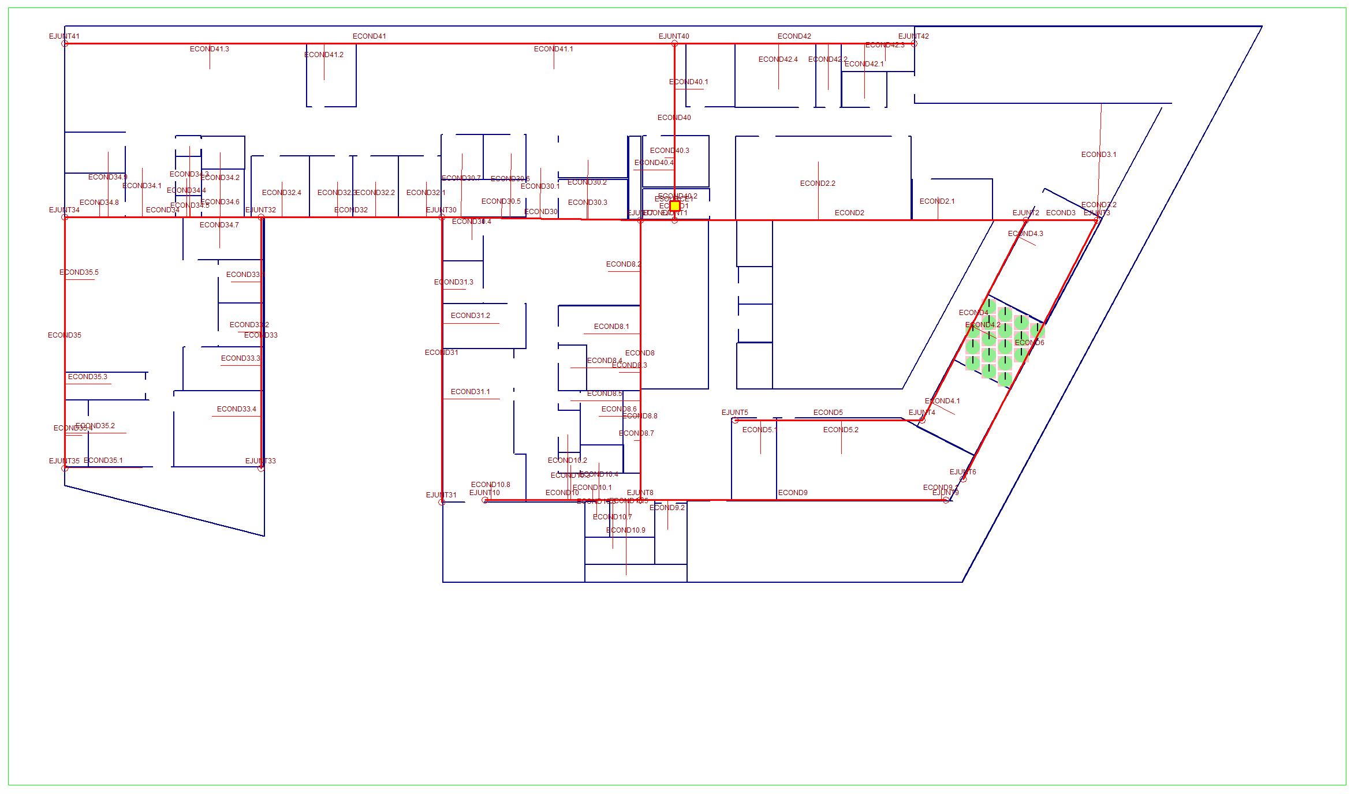
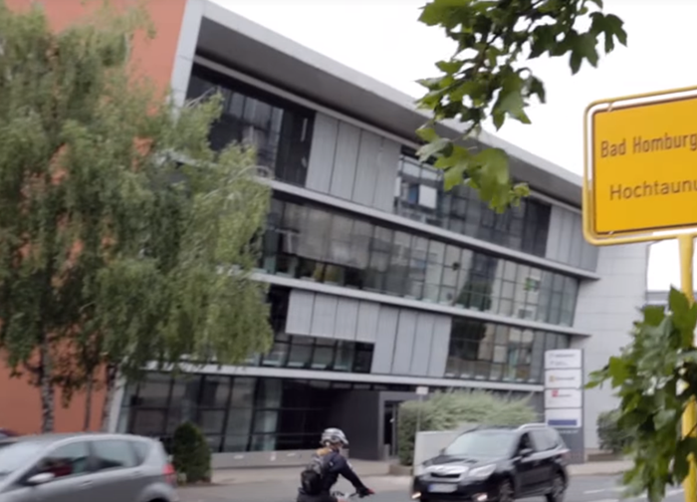
Microsoft Bad Homburg Office
Around 1300 Square Meters
Work place for about 200 people in Microsoft office, only about 50 at a time
Fairly new “modern workplace”: https://www.youtube.com/watch?v=1udWl6SeMc0
Used for indoor navigation experiments in Winter 2018
Added a (mostly fake) electric and airflow (HVAC) network for graph experiments

Slide 3
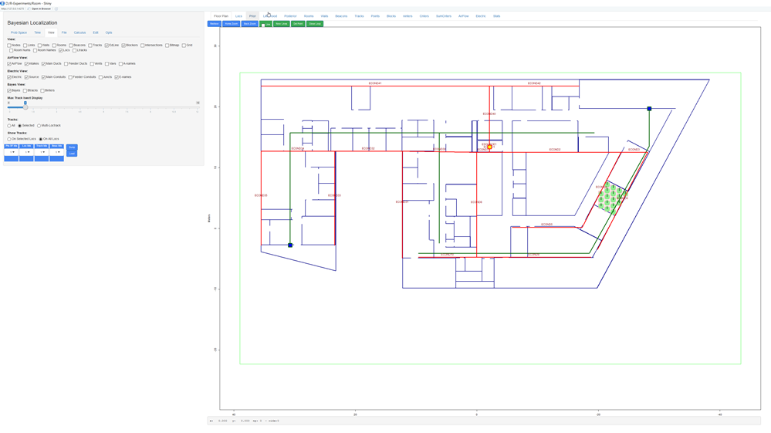
Application
R-Shiny – around 3200 lines
Initialized with hand coded data
Creates GSON file that can be loaded into gremlin/tinkerpop

Slide 4
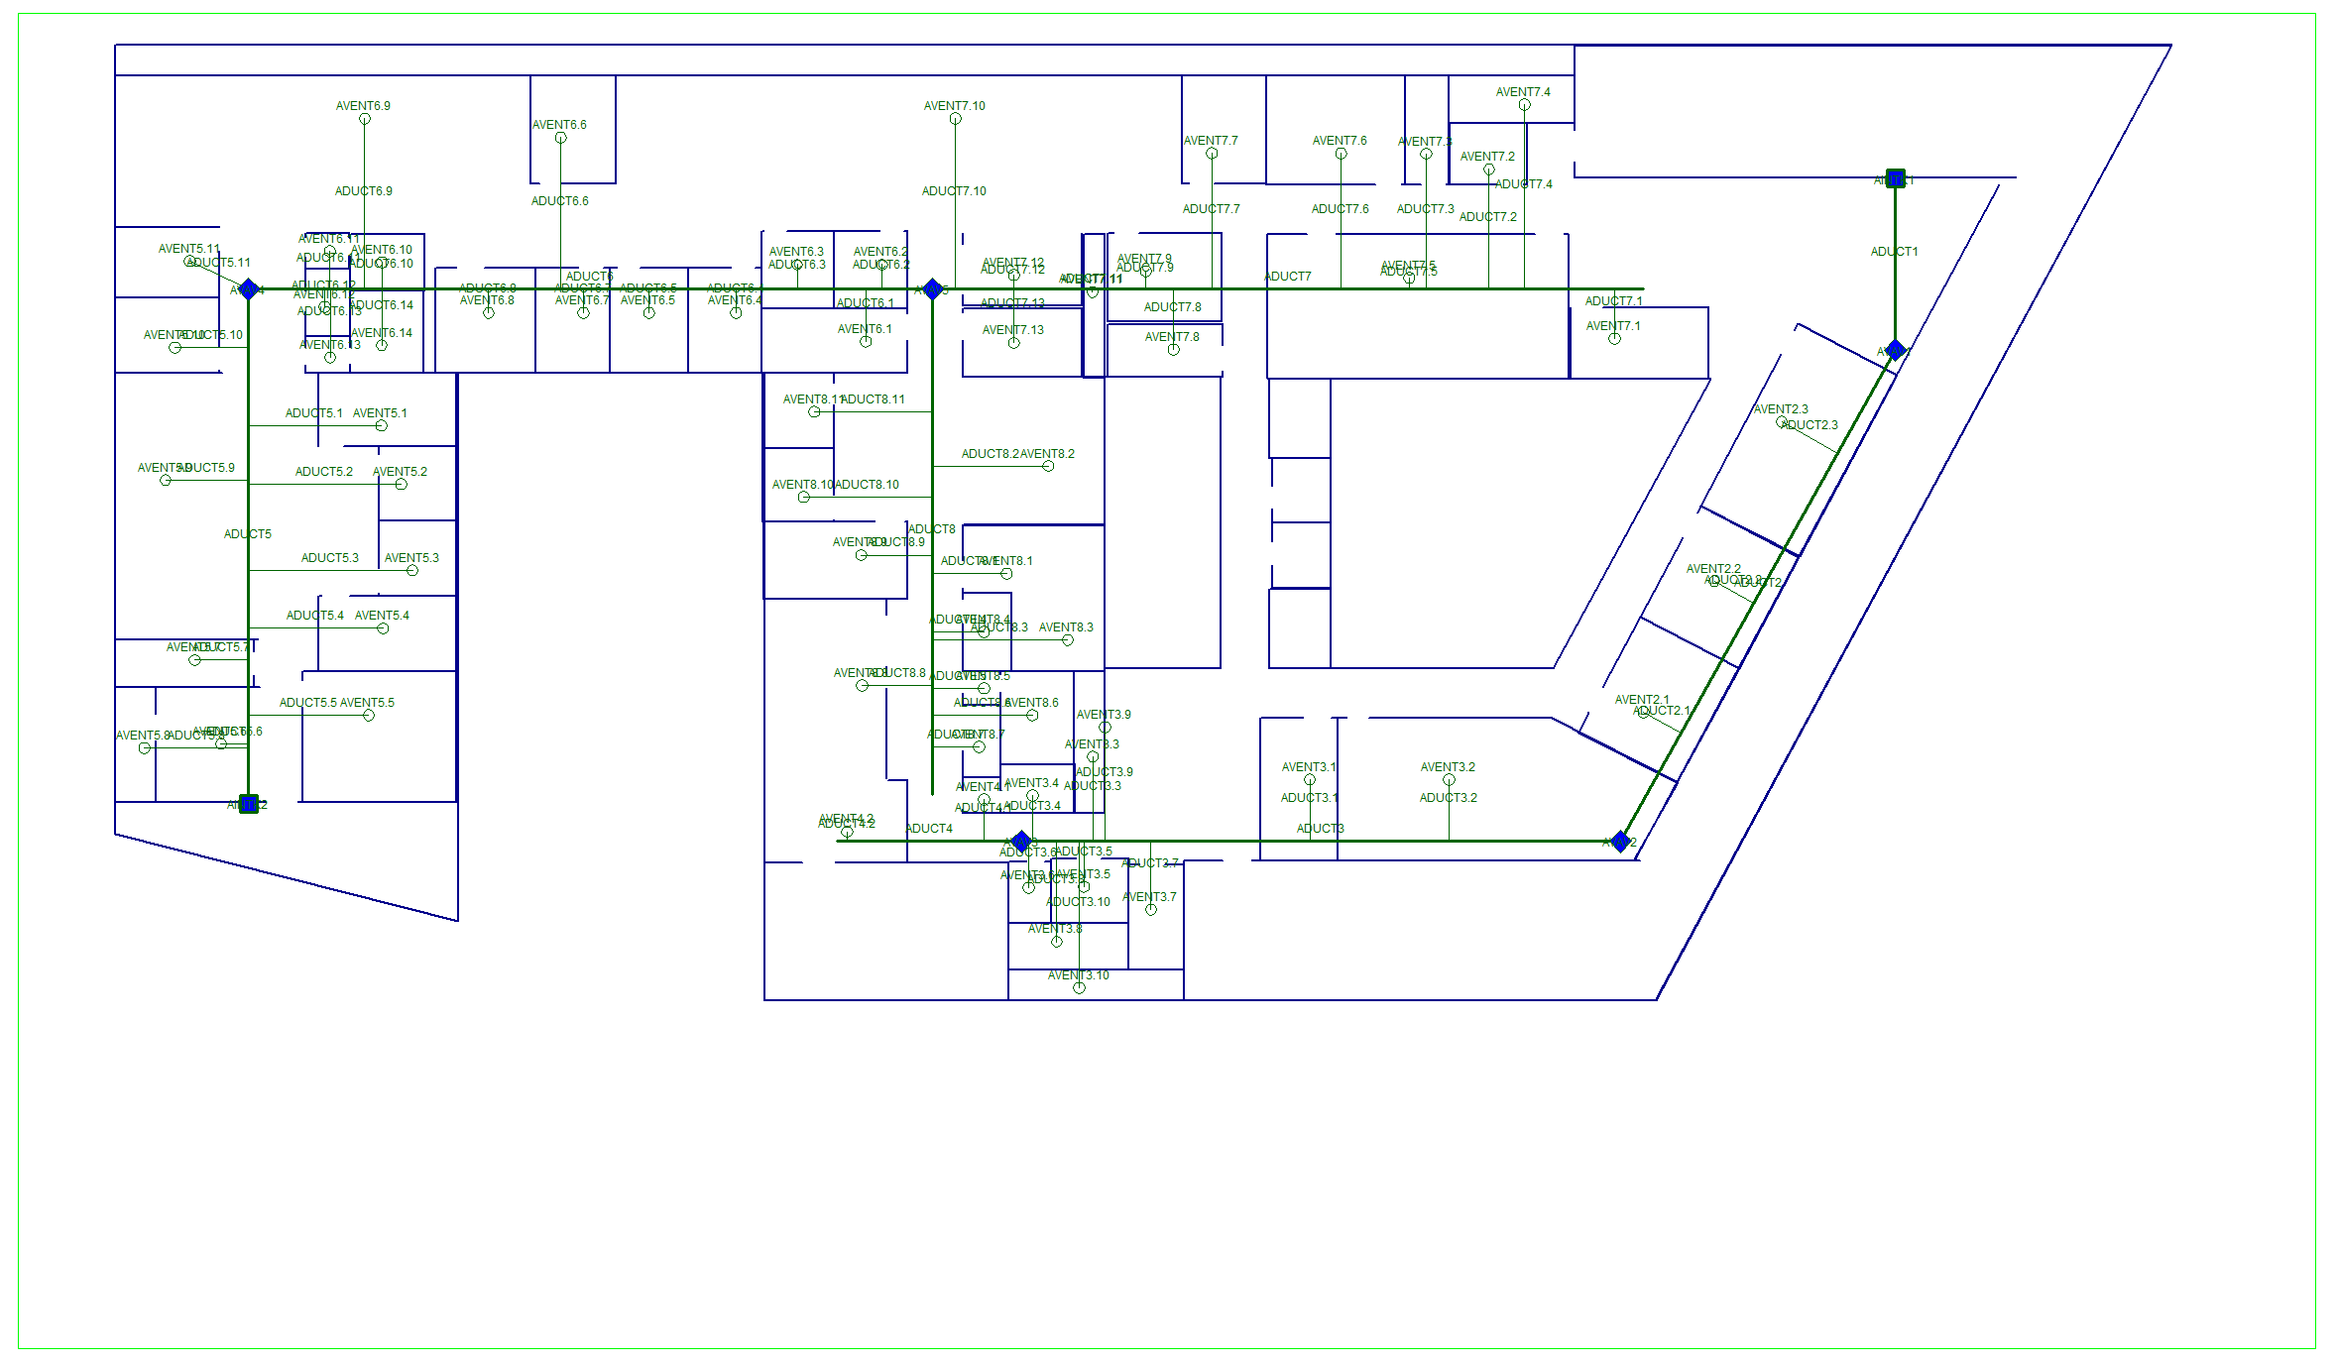




Airflow Graph
Vents in two locations
Airflow powered by
Components are
  Air ducts
  ADUCT.n (many)
  VAVS
  AVAVn (4 of them)
  Vents
  AVENTn.n (many)
  Joins
  AJOINn (many)
  Intakes
  AINTKn (2)

Slide 5
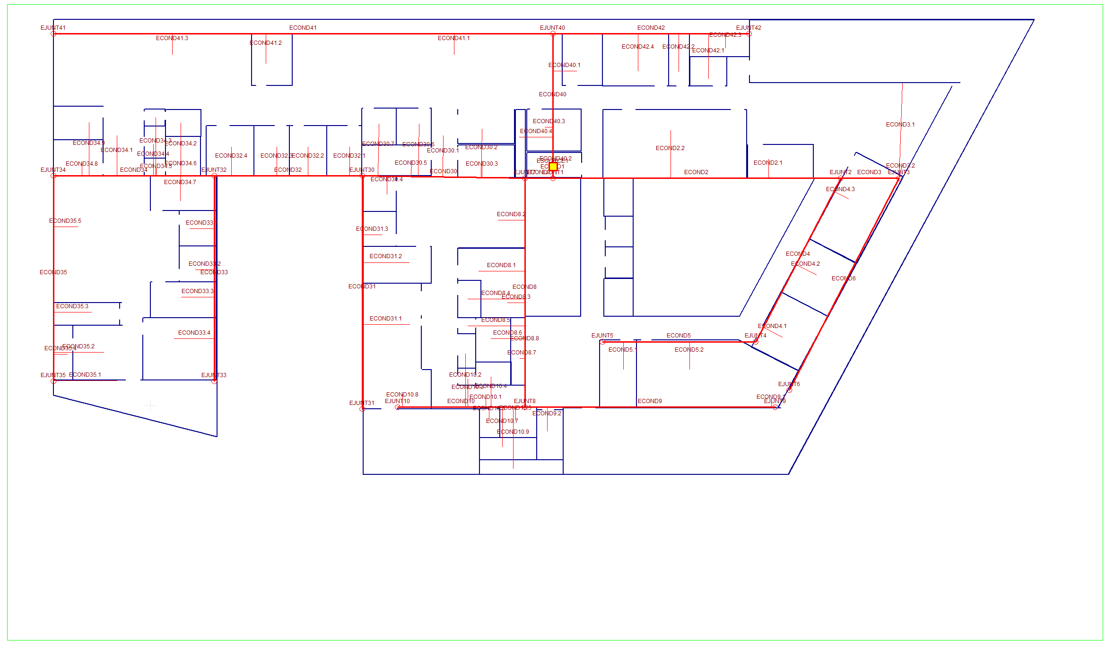



Electricity Graph
Comes in centrally and distributes electricity over building
Components are
  Conduits
  ECONDnn.n (many)
  Junctions
  EJUNCTnn (many)
  Source
  ESOURCE (1)

Slide 6
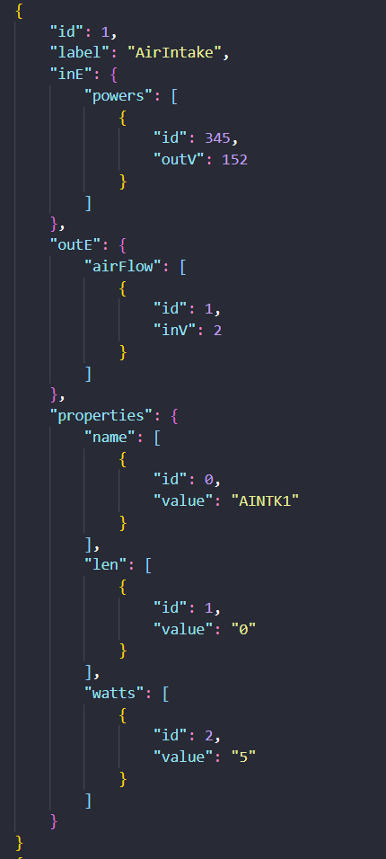
GSON Format
Not really JSON (serialized Java objects)
Written directly by application
All Airflow and Electric entities are “nodes”
“Links” are relationships between nodes
  “Powers” for electric entity relationship
  “Airflow: for air flowing between entities
So the electric conduits and airflow ducts are nodes too in this model, even though we tend to think of them as links

Slide 7
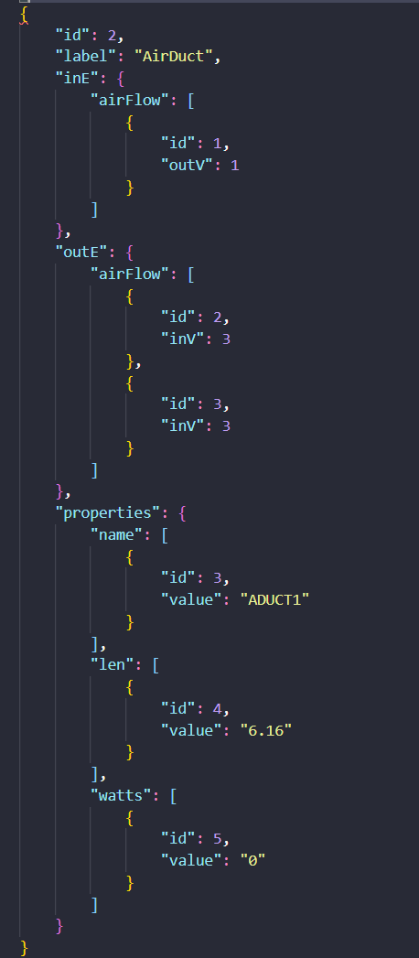
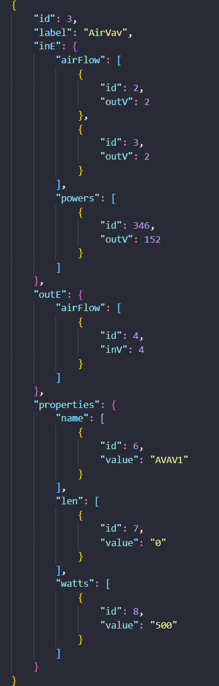
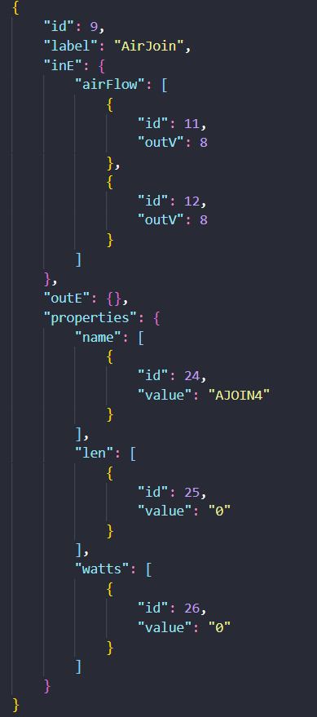
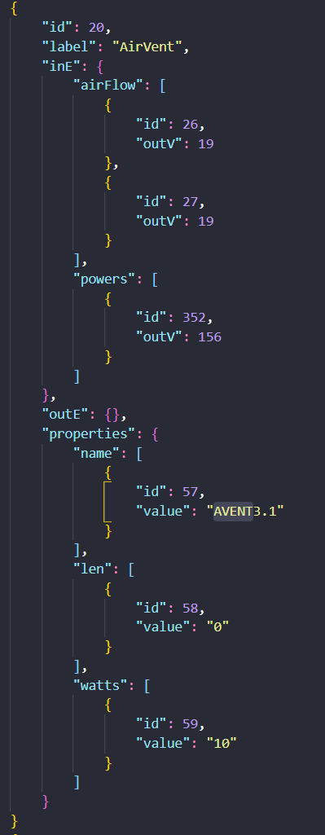
Airflow Entities

Slide 8
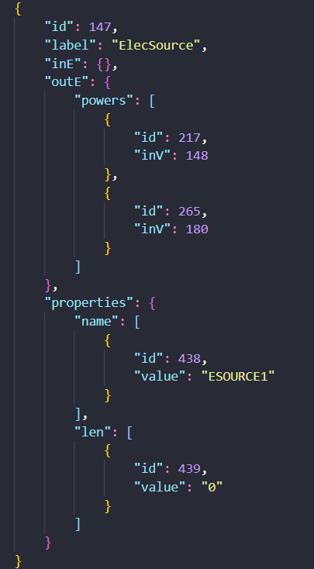
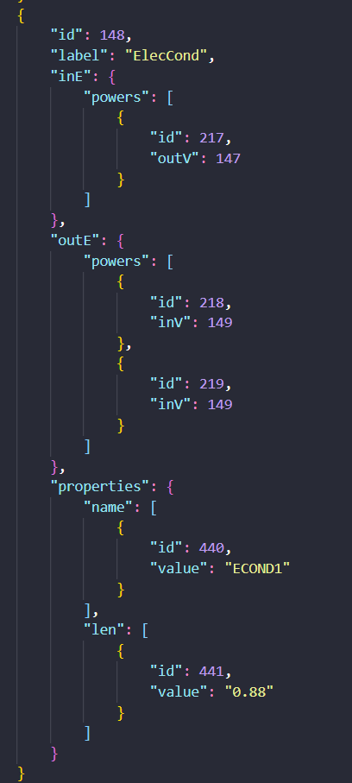
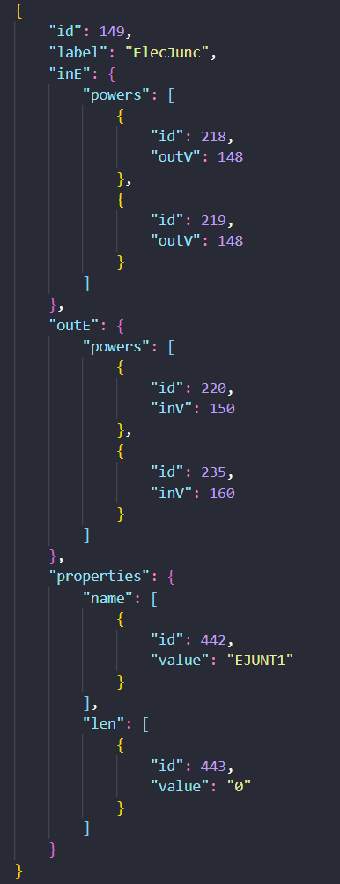
Electric Entities

Slide 9
Gremlin Session (with smallish test graph)
File "gson2.json" read in
Query size of graph
Query 1-jump "powers"
Query 2-jump "powers“
Find node number of ESOURCE1
Query paths for 2-jump
Query paths by name for 2-jump
Find path for id5 (ADJUCT3) to ESOURCE1
gremlin> g = TinkerGraph.open()
==>tinkergraph[vertices:0 edges:0]
gremlin> g.io(IoCore.graphson()).readGraph("gson2.json");
org.apache.tinkerpop.shaded.jackson.core.JsonParseException: Unrecognized token 'AirIntake': was expecting ('true', 'false' or 'null')
at [Source: java.io.ByteArrayInputStream@44d70181; line: 1, column: 29]
Display stack trace? [yN]
gremlin> g.io(IoCore.graphson()).readGraph("gson2.json");
==>null
gremlin> g
==>tinkergraph[vertices:27 edges:0]
gremlin> g = g.traversal()
==>graphtraversalsource[tinkergraph[vertices:27 edges:0], standard]
gremlin> g.V(1).valueMap()
==>[watts:[5], len:[0], name:[AINTK1]]
gremlin> g.V().values()
==>AINTK1
==>ADUCT1
... lots of them
gremlin> g.V().has('name','ESOURCE1').repeat(out('powers')).times(1).values('name')
==>ECOND40
==>ECOND1
gremlin> g.V().has('name','ESOURCE1').repeat(out('powers')).times(2).values('name')
==>EJUNT40
==>EJUNT40
==>EOUT1.3
==>EJUNT1
==>EJUNT1
==>EOUT1.1
==>EOUT1.2
gremlin> g.V().has('name','ESOURCE1')
==>v[147]
gremlin> g.V(147).repeat(out()).times(2).emit().path()
==>[v[147], v[192]]
==>[v[147], v[148]]
==>[v[147], v[192], v[147]]
==>[v[147], v[192], v[193]]
==>[v[147], v[192], v[193]]
==>[v[147], v[148], v[147]]
==>[v[147], v[148], v[151]]
==>[v[147], v[148], v[152]]
==>[v[147], v[148], v[152]]
==>[v[147], v[148], v[149]]
==>[v[147], v[148], v[150]]
gremlin> g.V().has('name','ESOURCE1').repeat(out('powers')).times(2).emit().path().by('name')
==>[ESOURCE1, ECOND40]
==>[ESOURCE1, ECOND1]
==>[ESOURCE1, ECOND40, EJUNT40]
==>[ESOURCE1, ECOND40, EJUNT40]
==>[ESOURCE1, ECOND1, EOUT1.3]
==>[ESOURCE1, ECOND1, EJUNT1]
==>[ESOURCE1, ECOND1, EJUNT1]
==>[ESOURCE1, ECOND1, EOUT1.1]
==>[ESOURCE1, ECOND1, EOUT1.2]
Gremlin> g.V(147).repeat(out().simplePath()).until(hasId(5)).path().by('name').limit(1)
==>[ESOURCE1, ECOND1, EJUNT1, ECOND7, EJUNT7, ECOND8, EJUNT8, ECOND9, AVAV2, ADUCT3]

